Slide 1

Sweet Talk:
What Sugar Does in Your Body
From the American Heart Association
Locally Sponsored by

Slide 2

What is Blood Glucose?
It’s the amount of sugar (glucose) in the blood.
When we eat food, our body makes glucose, a type of sugar. It travels in the blood to places in the body where energy is needed.
Other parts of the body need insulin to carry glucose into cells to be used as energy.
Notes:
SOURCE
https://www.heart.org/en/healthy-living/healthy-lifestyle/lifes-essential-8/how-to-manage-blood-sugar-fact-sheet

Slide 3
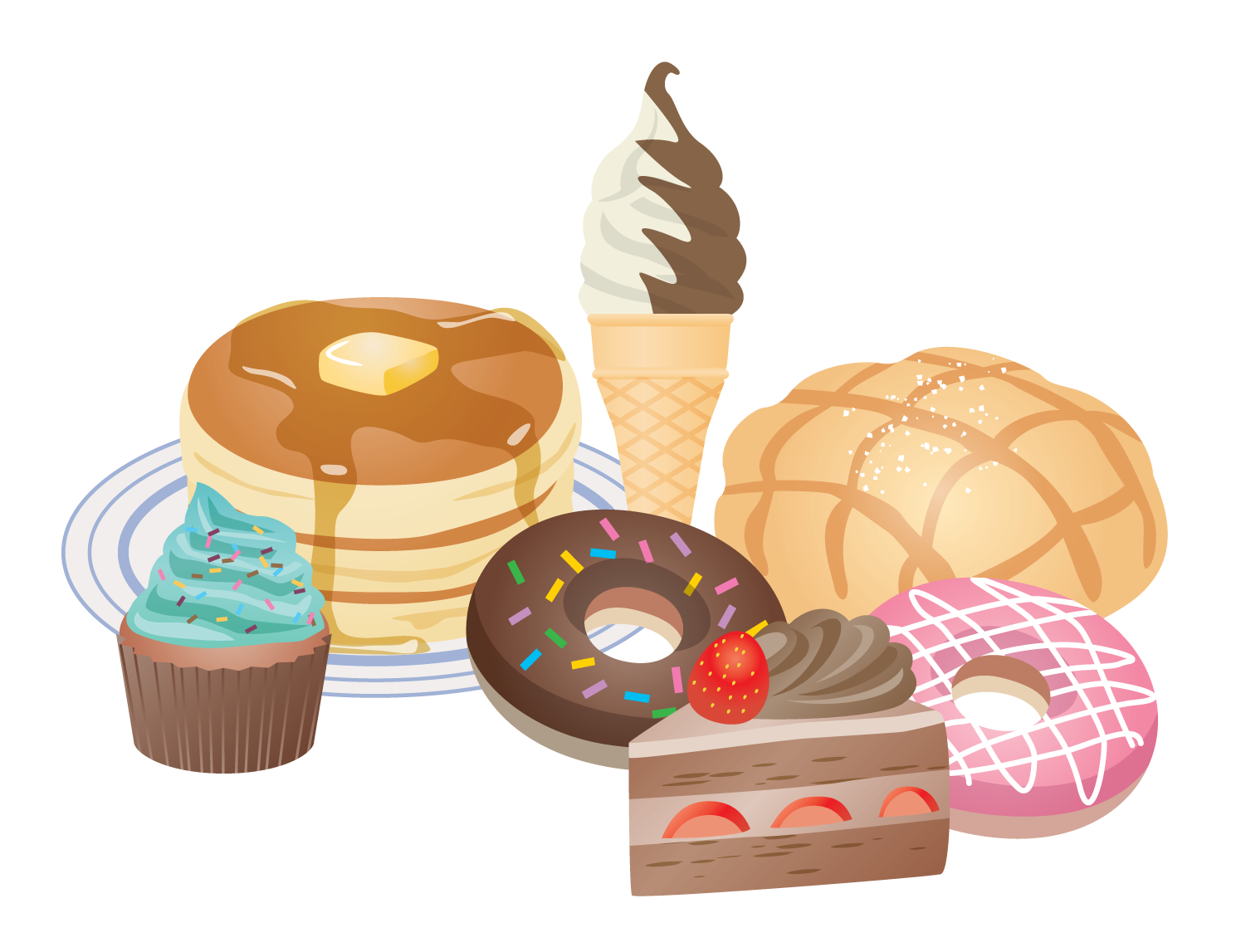
How Does High Blood Glucose
Affect Your Health?
High blood glucose, also known as hyperglycemia, can put you at greater risk of developing insulin resistance, prediabetes and type 2 diabetes.
Untreated diabetes can lead to many serious medical problems, including heart disease and stroke.
Notes:
SOURCE
https://www.goredforwomen.org/en/know-your-risk/know-your-numbers/key-numbers-to-know-for-your-heart-health-infographic

Slide 4
What is Diabetes?
There are two main types of diabetes: type 1 diabetes and type 2 diabetes.
TYPE 1 DIABETES
When the pancreas doesn’t make enough insulin at all. People with type 1 diabetes need to take insulin every day to help their bodies use glucose properly. They might need to use an insulin pen or insulin pump.
TYPE 2 DIABETES
When the body has trouble using insulin or doesn’t make enough of it. People with type 2 diabetes should focus on eating healthy foods, being active, and sometimes taking medicine or insulin to help their bodies use the glucose properly.
Notes:
SOURCE
https://www.heart.org/-/media/Healthy-Living-Files/LE8-Fact-Sheets/For-Kids/lifes_essential_8__for_kids_sweet_talk.pdf?sc_lang=en

Slide 5

Type 2 Diabetes and Blood Glucose Levels
In Type 2 diabetes, glucose builds up in the blood instead of going into cells because the body develops “insulin resistance” and can’t use its insulin efficiently.
The pancreas slowly loses its ability to produce insulin.
The result can be a high blood sugar level.
Notes:
SOURCE
https://www.heart.org/en/healthy-living/healthy-lifestyle/lifes-essential-8/how-to-manage-blood-sugar-fact-sheet

Slide 6
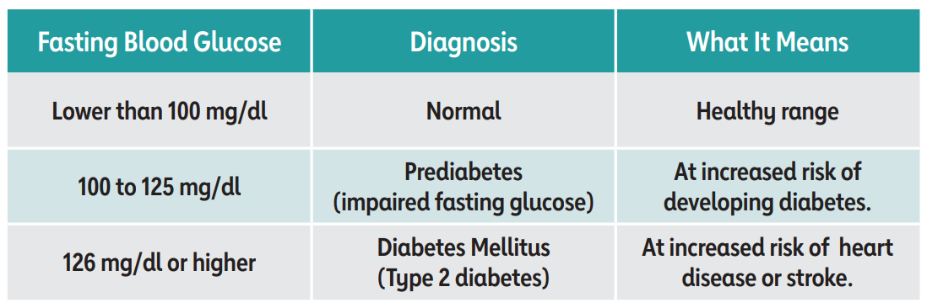
What’s a Healthy Blood Glucose Number?
Health care professionals can take blood sugar readings. If you are living with Type 2 diabetes, you may need to monitor your blood sugar level more often.
Notes:
SOURCE
https://www.heart.org/en/healthy-living/healthy-lifestyle/lifes-essential-8/how-to-manage-blood-sugar-fact-sheet

Slide 7
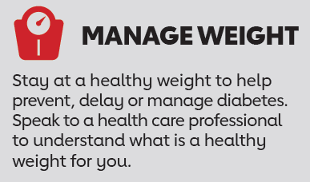
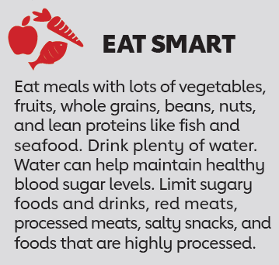
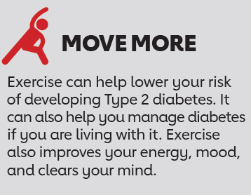
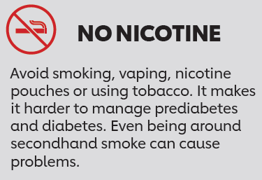
Tips to Manage Blood Sugar Levels
Notes:
SOURCE
https://www.heart.org/en/healthy-living/healthy-lifestyle/lifes-essential-8/how-to-manage-blood-sugar-fact-sheet

Slide 8


How to Talk to Kids About Blood Glucose
Eating too much sugar can be bad for our blood vessels, liver, kidneys, and other organs. Sugar is in candy, cakes and cookies, but you can also find it in other foods like bread, pasta, rice and potatoes.
When we eat sugar, it enters our bloodstream. Blood glucose, or blood sugar, is like a fuel that gives our bodies energy. Our pancreas, which is a special organ inside us, releases a hormone called insulin. Insulin acts like a key that unlocks our body’s cells to let the glucose in and give us energy.
It’s really important to have a doctor check our blood sugar and to eat healthy and move our bodies to keep our blood sugar levels healthy!
Sometimes, our bodies may not make enough insulin or have trouble using it. This can make our blood sugar levels go too high or too low. People with diabetes have trouble with their insulin. It’s like having a door that doesn’t open easily or a key that doesn’t work well. This means that the glucose can’t get inside the cells as it should.
Notes:
SOURCES
https://www.heart.org/-/media/Healthy-Living-Files/LE8-Fact-Sheets/For-Kids/lifes_essential_8__for_kids_sweet_talk.pdf?sc_lang=en

Slide 9



Easy Sugar Swaps
Too much sugar isn’t good for us. Here are some tips to cut back:
Unsweetened applesauce or mashed banana can used a sugar substitute in some recipes.
Swap traditional sugar-based desserts for fruit (fresh, frozen, or no-sugar-added canned options) – try them baked, grilled, stewed, or poached!
Swap sugar-sweetened beverages for plain or sparkling water flavored with mint, citrus, cucumber, or other fruits and herbs.
Notes:
SOURCE
https://www.heart.org/en/healthy-living/healthy-eating/eat-smart/sugar/life-is-sweet-with-these-easy-sugar-swaps-infographic

Slide 10
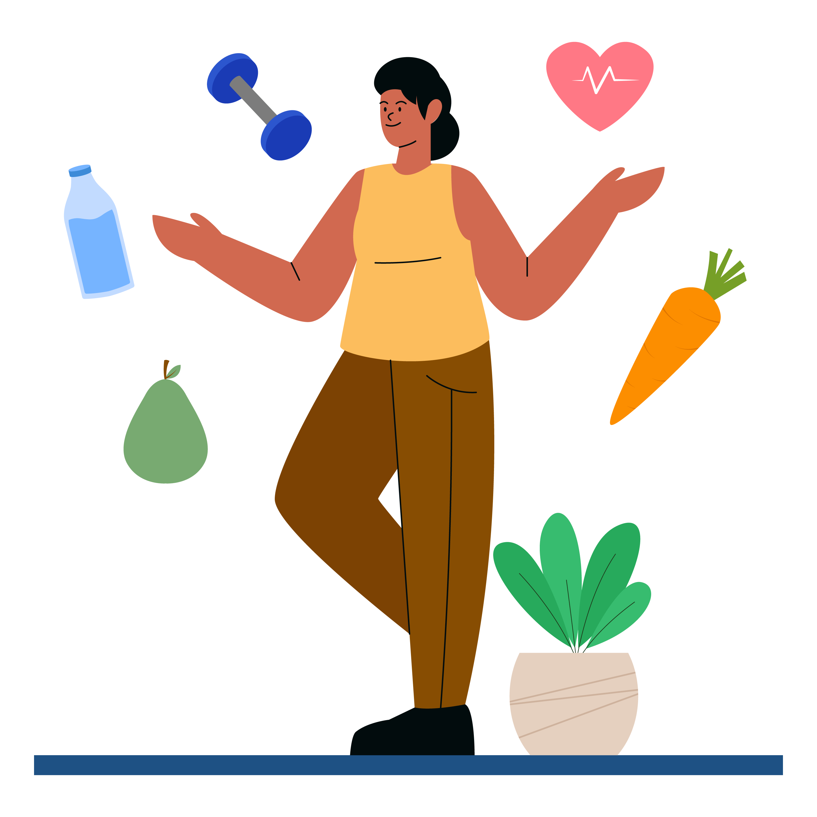
Wrap Up
Sugar gives your body fuel, but too much can be problematic and lead to diabetes and other health problems.
Have your blood sugar checked by a health care professional and manage your levels through healthy lifestyle choices like eating smart and moving more.

